Slide 1
Understanding Odor-Pitch Correspondence

Slide 2
Introduction- Historical Background - Attempts to Map Odors
5th century BC: Plato noted "varieties of smell have no name”
1895: Zwaardemaker's olfactometer - first quantitative measurement.
1916: Henning's "prism" model with six primary odors - Floral, Fruity, Resinous, Spicy, Burnt, Putrid.
1985, 1992: Dravnieks created the first large-scale empirical ‘odor map,’ based on standardized professional ratings of 146 odor descriptors and 144 odors.
Limited success in creating comprehensive odor classification systems.
Dravnieks (1985,1992); Henning (1916); Marks (1978); Zwaardemaker (1895)

Slide 3
Early Models
Henning's Prism (1916)
Six primary odors: floral, fruity, resinous, spicy, burnt, putrid
Odors as points within triangular prism structure
Schiffman & Erickson (1971)
Three-dimensional taste model using multidimensional scaling
Incorporated molecular weight, pH deviation, hedonic ratings
Schiffman (1974)
Two-dimensional smell model centered on pleasantness and sharpness

Slide 4
Modern Understanding
Pleasantness and Intensity as key organizing dimensions
~400 different olfactory receptors
Human capability to detect up to a trillion different smells
Limited vocabulary for description
Cultural variations in odor perception
146 perceptual descriptors

Slide 5

Introduction - The Semantic Challenge
Humans struggle with identifying and verbalizing odors, even familiar ones (identification rates <35%)
This issue is exemplified by the "tip-of-the-nose" phenomenon, where a familiar odor is recognized but cannot be named.
For instance, people often identify cinnamon as familiar yet fail to name it without visual or contextual clues.
Algom & Cain (1991); Spence (2020); Zellner (2013); Zellner et al. (1991)

Slide 6
Introduction - The Measurement Challenge
Vision: Munsell system (Hue, Value, Chroma)
Sound: Frequency (pitch) and amplitude (loudness)
Smell: No universal dimensional model
Gap in physics, chemistry, biology, and perception intersection

Slide 7
Cross-Modal Correspondences
Systematic relationships between different senses
Examples:
Brightness and loudness
Pitch and physical size
Color and temperature
Potential solution for odor classification.
Marks (1983); Melara (1989); Stevens (1975)

Slide 8
Current Research Focus
A
B
Investigating odor-pitch interactions
Two potential mechanisms
Low-level sensory integration - Synesthetic experience
Or
Semantic coding through metaphorical language

Slide 9

A1-Experiment Design and Stimuli
Participants: 2 professional perfumers
Materials: Sub 1 - 20 Odors Sub 2 - 45 odors
Task: Match odors to adjustable pitch (starting at 500Hz)
Two trials per odor, two weeks apart
Belkin et al. (1997)

Slide 10

Illustration By ChatGPT

Slide 11
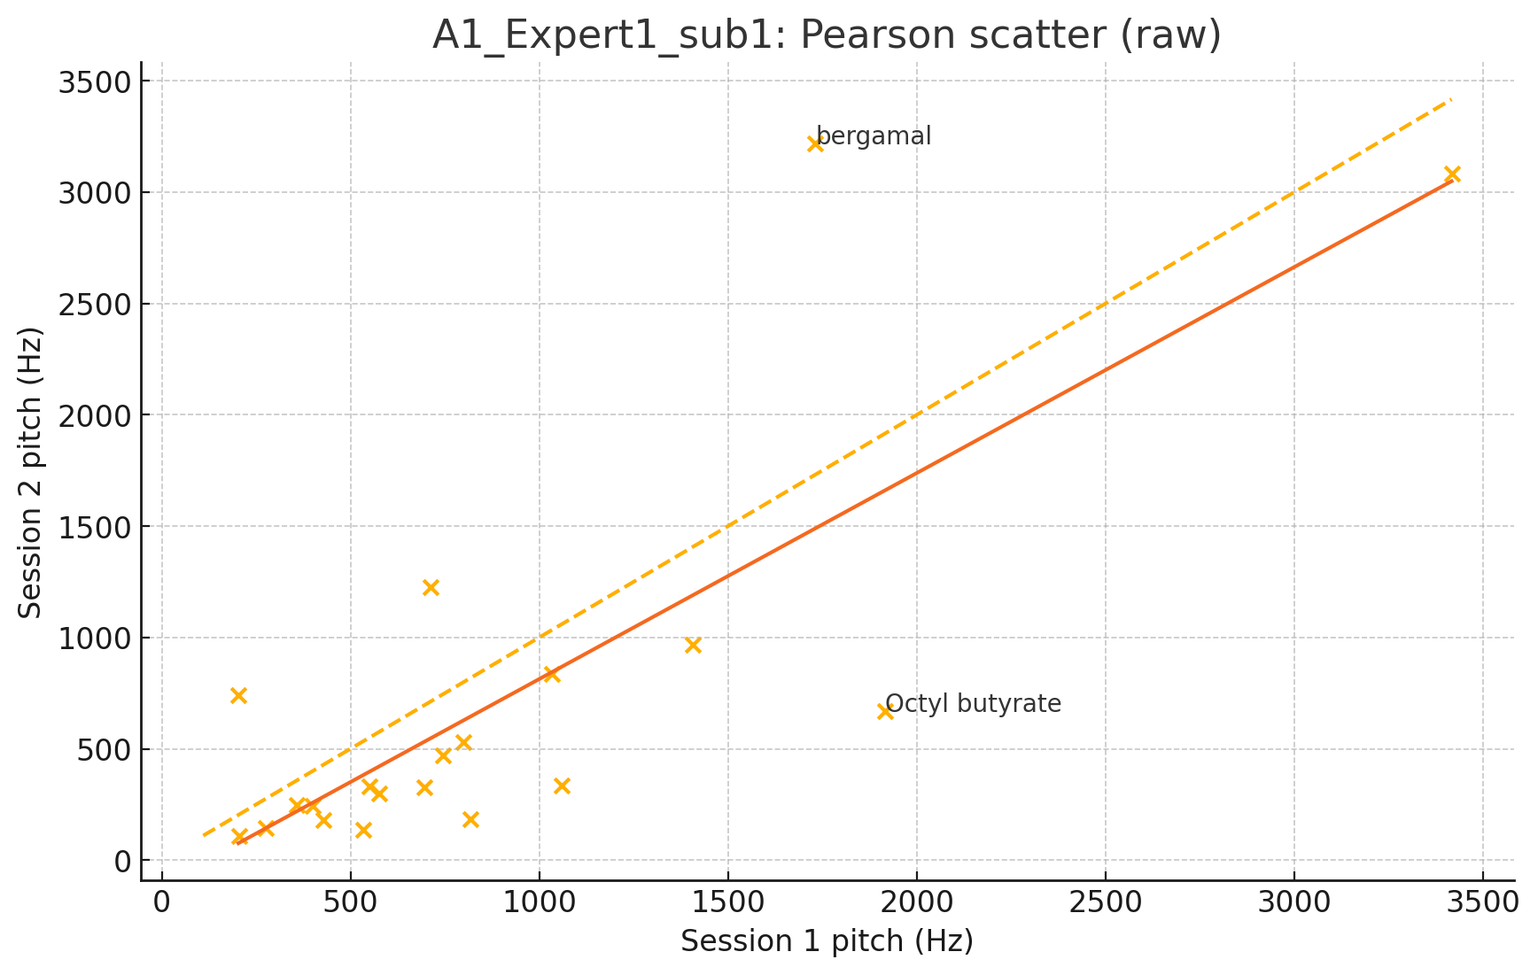
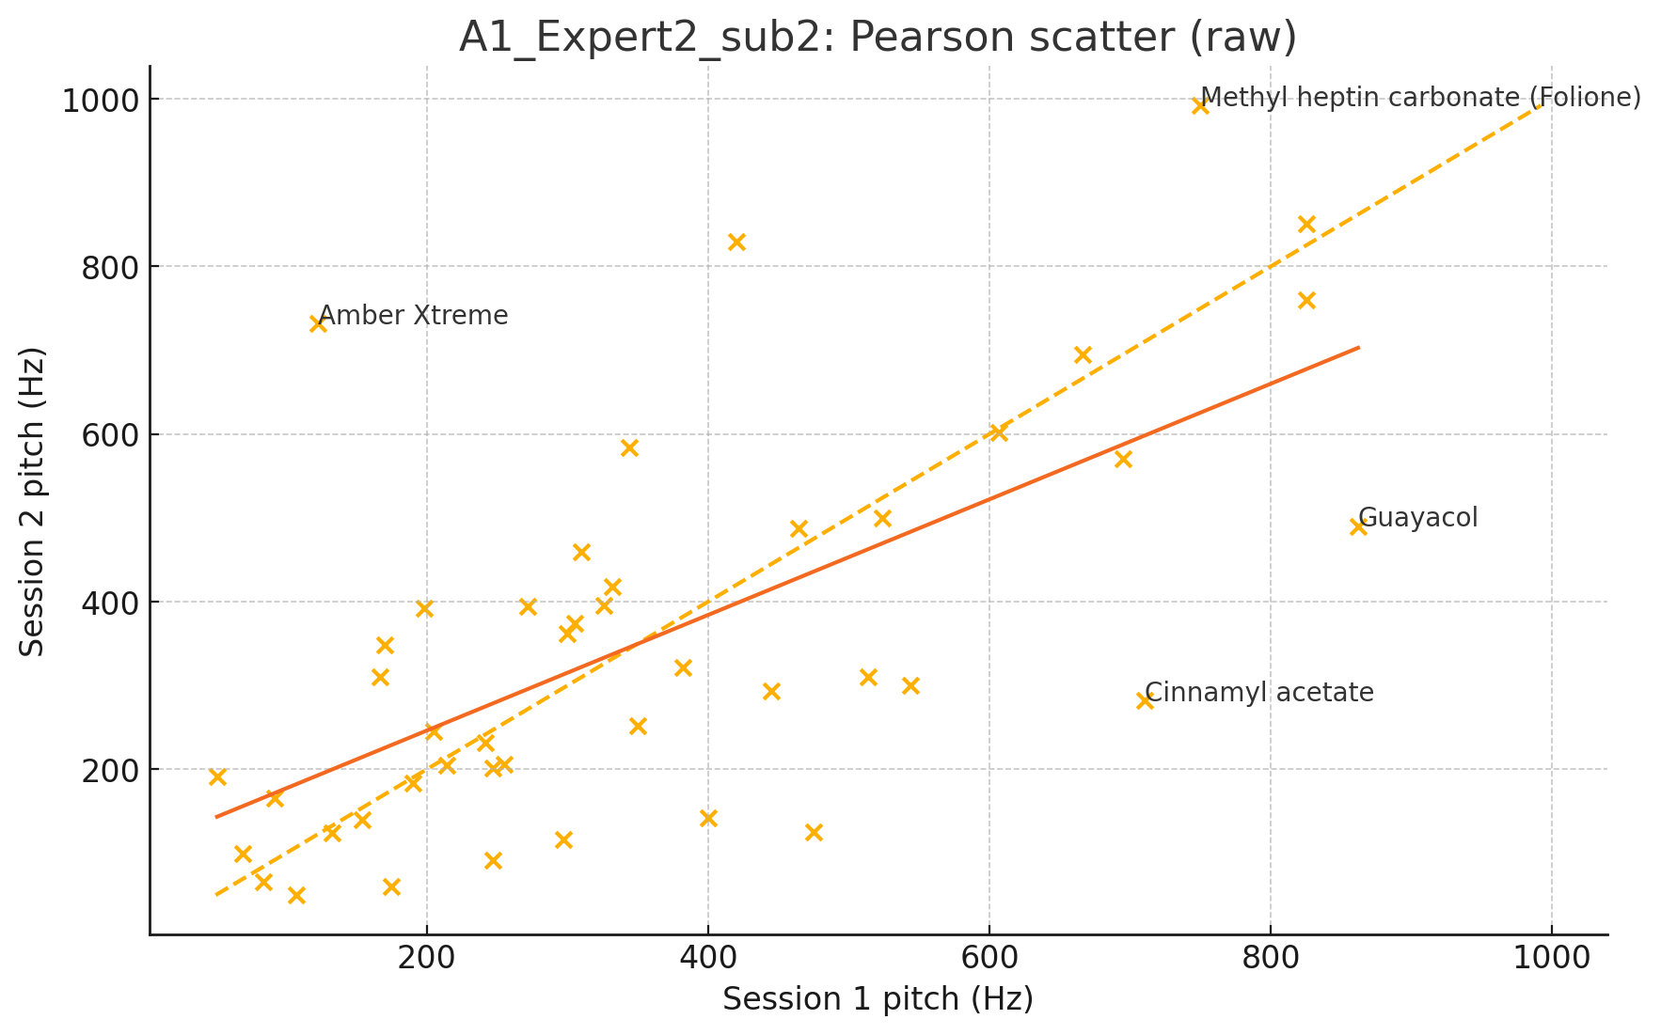
Experiment A1 - Experts
Subject 1
Results:
Perfumer 1 (20 odors): r = 0.79 correlation.
Perfumer 2 (45 odors): r = 0.66 correlation
Higher consistency than non-experts
Subject 2

Slide 12
A2-Experiment 2 Design and Stimuli
Participants: 40 adults
Materials: 7 Nameless odors, Pitch Generator
Eugenol, Cirtonelly, Linalool, Indole, Galaxolide, PEA, Gallbascone
Task: Match odors to adjustable pitch (starting at 500Hz)
Three trials per odor
Belkin et al. (1997)

Slide 13
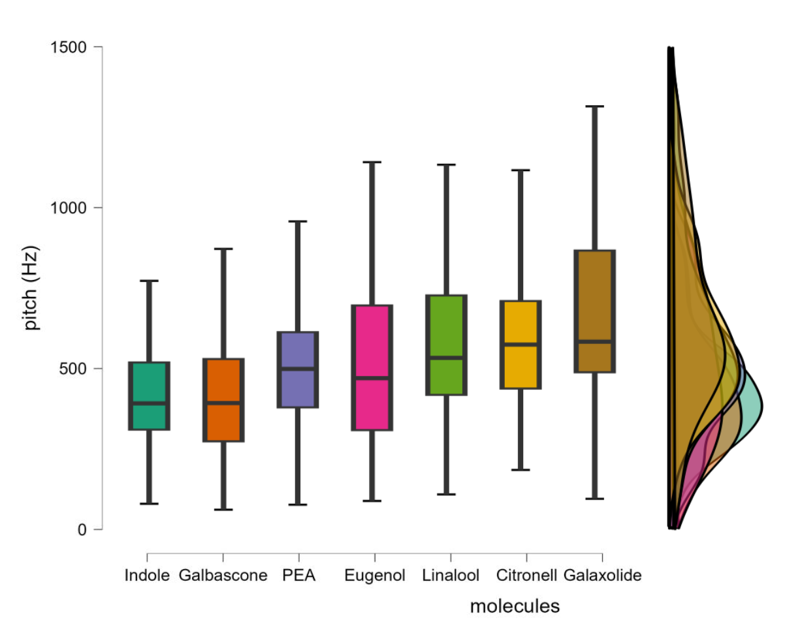
Experiment A2 Results
Average Sound Rating per Scent (Experiment 2)
Mean Pitch Associations:
Indole: \(481.02\) Hz (lowest)
PEA: \(540.20\) Hz
Eugenol: \(542.99\) Hz
Gallbascone: \(579.49\) Hz
Linalool: \(660.05\) Hz
Galaxolide: \(712.30\) Hz
Citronelly: \(745.07\) Hz (highest)
P<0.01

Slide 14
A3 - Experiment 3 Design and Stimuli
Participants: 26 adults
Same 7 odors
Four fixed pitch options:
\(481\) Hz, \(540\) Hz, \(712\) Hz, \(745\) Hz
Multiple trials per odor

Slide 15
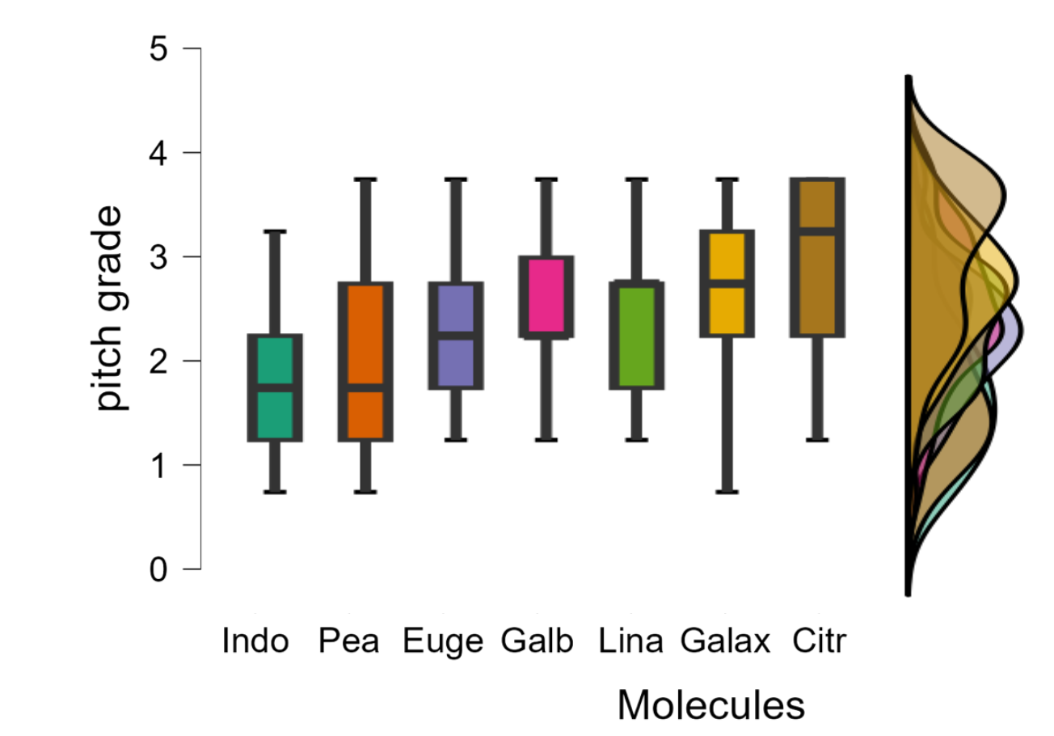
Experiment A3 Results
P<0.001
Notes:
Everage
Eugenol
2.72
Cirtonelly
2.01
Linolool
2.53
Indole
3.27
Galaxolide
2.15
PEA
2.90
Gallbascone
2.72

Slide 16
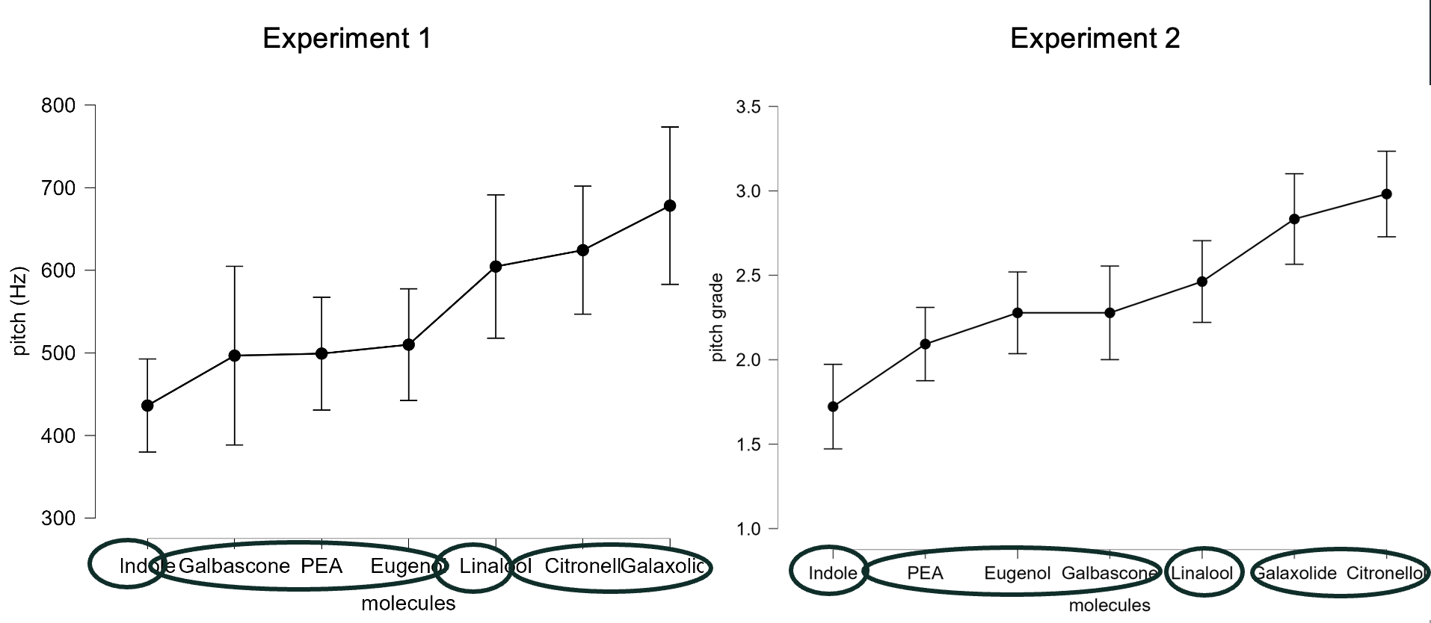
Study A2 VS Study A3
Experiment 2
Experiment 3

Slide 17
Key Findings
Systematic odor-pitch associations
Consistent patterns across experiments and methods
Expert and Naive validation
Potential for standardized scale development

Slide 18
The Research Question, What is the Mechanism?
Two Competing Hypotheses for Correspondence
Semantic Mapping Hypothesis: Associations emerge via linguistic or conceptual attributes. Example: "Sweet" odors (candied orange) matched with high-pitched musical instruments like piano. Or, associations based on repeated experiences or emotions. Example: Environmental odors influence behavior, such as fresh scents leading to longer stays in public areas.
Sensory-Level Integration Hypothesis: Direct neural integration at sensory levels. Example: Neural activation patterns linking odor intensity and auditory processing.
Anderson et al. (2003); Ba & Kang (2019a); Ba et al. (2020); Gilday & Mizrahi (2023); Marks (1978); Martino & Marks (2001); Zacharakis (2024, 2025)

Slide 19
Our Hypothesis: Sensory-Perceptual Integration
Consistent odor-pitch pairings across expert and non-expert participants (Studies A1, A2, A3).
Critically, odors were presented without semantic labels, eliminating linguistic influences.
Pairings are stable within and between individuals, independent of semantic labels (Nameless Odors).
Symmetrical and robust associations were observed across methodological variations.
Odor-pitch correspondences arise from integral sensory-perceptual processing.

Slide 20
From Theory to Empirical Testing
Having proposed the Sensory-Perceptual Integration hypothesis, the next critical step is empirical validation. Garner’s Speeded Classification Paradigm precisely tests whether perceptual dimensions are integral or separable, making it ideal for verifying sensory-level perceptual integration.

Slide 21
Understanding Garner Paradigm
Purpose: Evaluate perceptual independence between dimensions
Example: Rectangle classification
Relevant dimension: Height
Irrelevant dimension: Width
Tests ability to focus on one dimension while ignoring another

Slide 22
Garner Paradigm Details
Three conditions: Baseline, Filtering and Correlation
Garner Interference (GI) equation:
GI = MRT(F) - MRT(B)
Where:
MRT(F) = Mean Reaction Time in Filtering
MRT(B) = Mean Reaction Time in Baseline
Higher interference in Filtering suggest dimension integration
MRT(C) = Mean Reaction Time in Correlation
Higher redundancy gains in Correlation suggest dimension integration

Slide 23
Why Garner’s Paradigm?
Specifically designed to differentiate between perceptual and cognitive processes.
Effectively separates integral (automatic) from separable (attention-driven) sensory interactions.
Widely validated in multisensory and cognitive research, providing clear interpretations.
Ability to measure by Blocks.
Algom & Fitousi (2016); Garner (1974)

Slide 24
Empirical Testing with Garner’s Paradigm
Garner’s paradigm differentiates integral (automatic) from separable (cognitive or conceptual) processing of sensory dimensions.
Our Predictions:
Garner’s paradigm distinguishes integral from separable dimensions by comparing performance across baseline, filtering, and correlated conditions.
Filtering condition: We predict significant interference relative to the baseline, indicating difficulty ignoring irrelevant dimensions, evidence for perceptual integration.
Correlation condition: We predict redundancy gains, particularly when the pitch-odor pairing aligns with expected perceptual mappings. Differences between positive and negative correlations suggest a structured relationship between odor quality and pitch not merely a function of intensity but a deeper, shared perceptual dimension.

Slide 25
Garner’s Paradigm & Stroop Effect
The Filtering Condition (Measuring Conflict):
Mechanism: Since the irrelevant dimension varies randomly, it creates both congruent and incongruent trials within the same block.
Measure: We calculate Stroop Congruity by subtracting the mean RT of Congruent trials from Incongruent trials (RT Inc - RT Con).
Significance: A significant effect indicates a failure of selective attention due to conflicting information.
The Correlation Condition (Measuring Facilitation):
Mechanism: The irrelevant dimension covaries perfectly with the target, eliminating conflict and serving as a predictive cue.
Measure: We calculate Redundancy Gain by subtracting the mean RT of the Correlation block from the Baseline block (RT Base – RT Corr).
Significance: Faster performance here (compared to baseline) confirms integral processing, where the "irrelevant" dimension facilitates the response.
Pansky & Algom (1999, 2002); Mama et al,. (2013).
P

Slide 26
Theoretical Implications
Cross-modal correspondences are robust
Multiple processing levels are involved
Potential for new classification system
Bridge between sensory modalities

Slide 27

Limitations
Individual differences in perception
Cultural variations
Environmental factors
Measurement precision
Sample size considerations
RT in Odors
Deroy (2023); Endevelt-Shapira et al. (2014); Yeshurun & Sobel (2010)

Slide 28
Practical Applications
Perfume industry standardization
Medical diagnostics
Food and beverage industry
Environmental monitoring

Slide 29
Future Research Directions
Neural basis investigation
Cultural comparison studies
Long-term stability testing
Application development
Expanding odor-sound matching research to additional molecules
Scale refinement
Deroy (2023); Spence (2020); Yeshurun & Sobel (2010)

Slide 30
References
Algom, D., & Cain, W. S. (1991). Remembered odors and mental mixtures: Tapping reservoirs of olfactory knowledge. Journal of Experimental Psychology: Human Perception and Performance, 17, 1104-1119.
Algom, D., & Fitousi, D. (2016). Half a century of research on Garner interference and the separability-integrality distinction. Psychological Bulletin, 142, 1352-1383.
Anderson, A. K., Christoff, K., Stappen, I., Panitz, D., Ghahremani, D. G., Glover, G., & Sobel, N. (2003). Dissociated neural representations of intensity and valence in human olfaction. Nature Neuroscience, 6(2), 196-202.
Ashkenazi, A., & Marks, L. E. (2004). Effect of endogenous attention on detection of weak gustatory and olfactory flavors. Perception & Psychophysics, 66(4), 596-608.
Ba, M., & Kang, J. (2019a). A laboratory study of the sound-odour interaction in urban environments. Building and Environment, 147, 314-326.
Ba, M., Kang, J., & Li, Z. (2020). The effects of sounds and food odour on crowd behaviours in urban public open spaces. Building and Environment, 182, 107104.
Belkin, K., Martin, R., Kemp, S. E., & Gilbert, A. N. (1997). Auditory pitch as a perceptual analogue to odor quality. Psychological Science, 8, 340-342.
Cooper, J., & Hutchinson, D. S. (1997). Plato: Complete works. Indianapolis, IN: Hackett.
Deroy, O. (2023). Olfactory abstraction: a communicative and metacognitive account. Philosophical Transactions of the Royal Society B, 378(1870), 20210369.
Di Stefano, N., & Spence, C. (2023). Perceptual similarity: Insights from crossmodal correspondences. Review of Philosophy and Psychology, 15, 997-1026.
Dravnieks, A. (1985, 1992). Atlas of odor character profiles.‏
Endevelt-Shapira, Y., Shushan, S., Roth, Y., & Sobel, N. (2014). Disinhibition of olfaction: human olfactory performance improves following low levels of alcohol. Behavioural Brain Research, 272, 66-74.
Garner, W. R. (1974). The processing of information and structure. Potomac, MD: Erlbaum.
Gilday, O. D., & Mizrahi, A. (2023). Learning-induced odor modulation of neuronal activity in auditory cortex. Journal of Neuroscience, 43, 1375-1386.
Henning, H. (1916). Der Geruch. Leipzig: Barth.
Mama, Y., Ben-Haim, M. S., & Algom, D. (2013). When emotion does and does not impair performance: A Garner theory of the emotional Stroop effect. Cognition & emotion, 27(4), 589-602.‏
Marks, L. E. (1978). The unity of the senses: Interrelations among the modalities. New York: Academic Press.
Marks, L. E. (1983). Similarities and differences among the senses. International Journal of Neuroscience, 19, 1-12.
Martino, G., & Marks, L. E. (2001). Synesthesia: Strong and weak. Current Directions in Psychological Science, 10, 61-65.
Melara, R. (1989). Dimensional interactions between color and pitch. Journal of Experimental Psychology: Human Perception and Performance, 15, 69-79.
Pansky, A., & Algom, D. (1999). Stroop and Garner effects in comparative judgment of numerals: The role of attention. Journal of Experimental Psychology: Human Perception and Performance, 25(1), 39.‏
Pansky, A., & Algom, D. (2002). Comparative judgment of numerosity and numerical magnitude: attention preempts automaticity. Journal of Experimental Psychology: Learning, Memory, and Cognition, 28(2), 259.‏
Schiffman, S. S., & Erickson, R. P. (1971). A psychophysical model for gustatory quality. Physiology & behavior, 7(4), 617-633.‏
Schiffman, S. S. (1974). Physicochemical Correlates of Olfactory Quality: A series of physicochemical variables are weighted mathematically to predict olfactory quality. Science, 185(4146), 112-117.‏
Spence, C. (2020). Olfactory-colour crossmodal correspondences in art, science, and design. Cognitive Research: Principles and Implications, 5, 52.
Stevens, S. S. (1975). Psychophysics: Introduction to its perceptual, neural and social prospects. New York: Wiley-Blackwell.
Yeshurun, Y., & Sobel, N. (2010). An odor is not worth a thousand words: From multidimensional odors to unidimensional odor objects. Annual Review of Psychology, 61, 219-241.
Zacharakis, A. (2024). Sonic bouquet: Decoding cross-modal correspondences between timbre and scent. Music & Science, 7, 20592043241274258.
Zacharakis, A. (2025). The poetry of senses: Exploring semantic mediation in timbre-aroma correspondences. Frontiers in Psychology, 16, 1520046.
Zarzo, M. (2008). Psychologic dimensions in the perception of everyday odors: pleasantness and edibility. Journal of Sensory Studies, 23(3), 354-376.
Zellner, D. A. (2013). Color-odor interactions: A review and model. Chemosensory Perception, 6, 155-169.
Zellner, D. A., Bartoli, A. M., & Eckard, R. (1991). Influence of color on odor identification and liking ratings. The American Journal of Psychology, 104, 547-561.
Zwaardemaker, H. (1895). Die Physiologie des Geruchs. Leipzig: Engelmann.

